Slide 1

Major Project – MCA491P
IoT Based Smart Irrigation in Arecanut Farms
1RV23MC039
HARI KETAN T
Under the Guidance
Of
Dr. Renuka Prasad B
Associate Professor
Department of MCA

Slide 2
Agenda
Introduction and Objectives
Implementation
Testing
Results
Conclusion
References

Slide 3
Introduction and Objectives
Introduction
Arecanut is a vital commercial crop in India, especially in states like Karnataka, Kerala, and Tamil Nadu, where it supports thousands of small and medium-scale farmers.
Traditional irrigation methods for arecanut farms are mostly manual, leading to water wastage, inconsistent irrigation, and higher labor dependency.
This project aims to build a smart irrigation system that automates and optimizes water usage based on real-time soil and environmental conditions.
The system is designed to promote precision agriculture, improving crop yield while conserving water and reducing human effort.
It uses a rule-based irrigation logic inspired by the Soil Moisture Deficit (SMD) model to determine when and how much to irrigate
Objective
To develop an IoT-based smart irrigation system
Automate irrigation in arecanut farms using IoT devices to reduce manual work.
Monitor soil moisture and water flow using sensors to ensure proper watering.
Control water flow with a motorized valve based on real-time sensor readings.
Display live data on a web interface to help farmers monitor conditions remotely.
Set irrigation schedules using simple rule-based logic based on crop needs.

Slide 4
Implementation
Module Name: Soil Moisture Monitoring
Purpose: To continuously measure soil moisture and determine irrigation need.
Input: Analog signal from capacitive soil moisture sensor.
Process: Converts sensor data to digital, compares against threshold, sends to backend.
Output: Moisture percentage, timestamp, and section ID pushed via MQTT.
Module Name: Water Requirement Calculation
Purpose: To fetch the ideal water requirement for a section based on crop age, month, and soil.
Input: Soil type, current month, plant age (from planting date).
Process: Fetches required value from Water_Requirement table.
Output: Ideal liters/day/palm value used by decision logic.
Module Name: Irrigation Control (Auto/Manual)
Purpose: To control the valve state based on logic or manual command.
Input: Mode (AUTO/MANUAL), moisture value, required water, user input.
Process: If AUTO: checks if moisture < threshold; triggers relay via Raspberry Pi. If MANUAL: user control overrides logic.
Output: Valve ON/OFF signal, recorded in control log.
Module Name: Water Flow Monitoring
Purpose: To measure actual water delivered during irrigation.
Input: Digital pulses from flow sensor (YF-S201).
Process: Converts pulses to L/min, multiplies by duration to get volume.
Output: Water volume in liters; logs for accuracy tracking.

Slide 5
Testing
Test Case_ID | Feature Tested | Sample Input | Expected Output | Actual Output | Remarks (Pass/Fail)
TC_1 | Farmer Registration | Name: "Test Farmer" Email: "farmer@gmail.com" Password: "Pass123!" | User account is successfully created in the database. A "Registration Successful" message is displayed. The user is redirected to the login page. | “Registration Successful" message is displayed. The user is redirected to the login page | Pass
TC_2 | Farmer Registration | Name: "Another Farmer" Email: " farmer@gmail.com" (Email already exists in the system) | Registration is denied. An error message "Email is already registered" is displayed to the user. The user remains on the registration page. | Email is already registered" is displayed to the user. The user remains on the registration page. | Pass
TC_3 | Farmer Login | Email: "farmer@gmail.com" Password: "Pass123!" | The user is successfully authenticated. The system redirects the user to the main dashboard. | Login Successful and redirects to the dashboard | Pass
TC_4 | Farmer Login | Email: "farmer@gmail.com" Password: "AnyPassword" | Authentication fails. A generic error message "Invalid email or password" is displayed. | Login Unsuccessful and stays in the same page | Pass

Slide 6
Results
Obtained results (Articulate the results obtained)
To develop an IoT-based smart irrigation system
Control water flow with a motorized valve based on real-time sensor readings.
Automate irrigation in arecanut farms using IoT devices to reduce manual work.

Slide 7
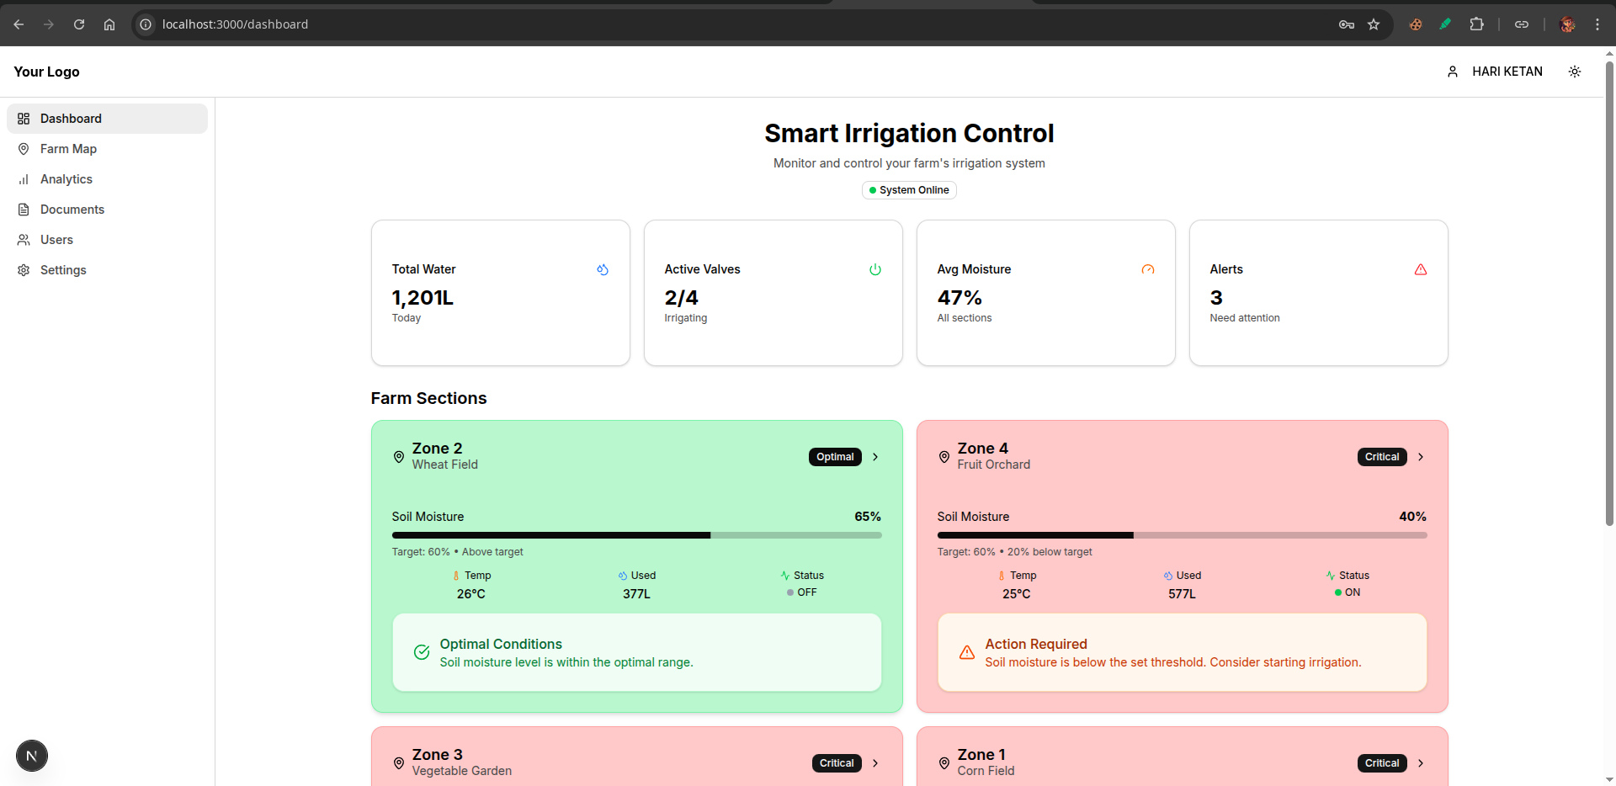
Screen shots of Results

Slide 8
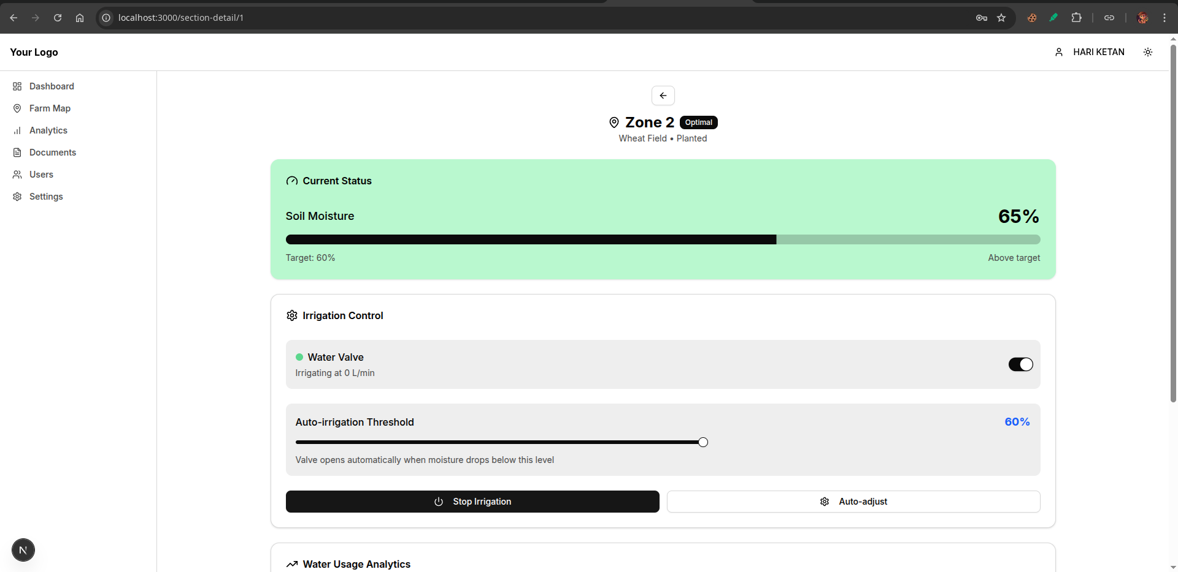
Screen shots of Results

Slide 9
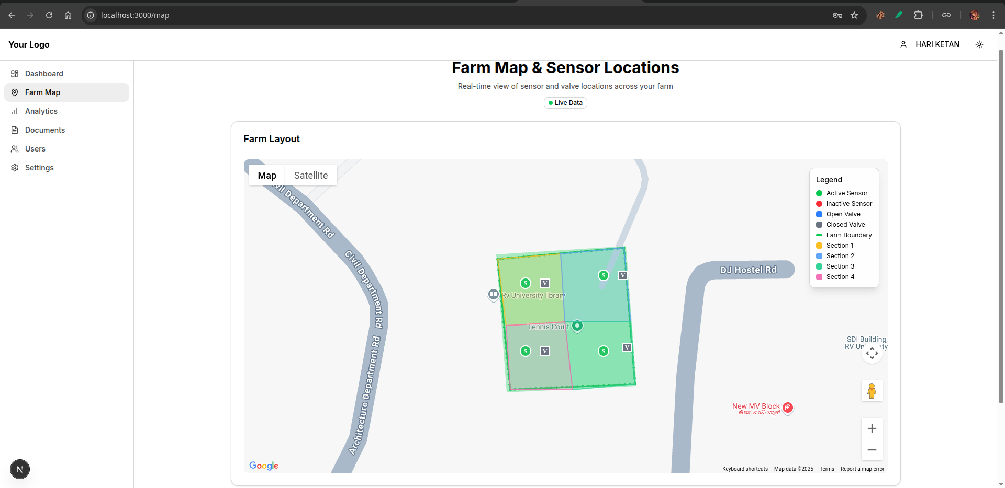
Screen shots of Results

Slide 10
Conclusion
Specify the conclusion pointwise

Slide 11
Future Enhancements
1. Advanced Intelligence and Predictive Analytics
Weather Forecast Integration
Machine Learning for Predictive Irrigation
2. Integrated Farm Management Features
Smart Fertigation System
Expanded Environmental Sensing
3. Sustainability and Robustness
Solar Power Integration

Slide 12
References
[1] SharathKumar KR, Mohan K, and Nirisha, “Arecanut Crop Disease Prediction using IoT and Machine Learning”, Journal of Science; Technology , vol. 5, no. 3, pp. 160–165, May 2020.
[2] Jyothi R, Rachana S, Ranjitha R, Krishna Prasad R, “Smart Irrigation System Based on Iot”, IJAST, vol. 29, no. 3, pp. 5730 - 5737, Mar. 2020.
[3] A. J. Rao, C. Bekal, Y. R. Manoj, R. Rakshitha, N. Poornima, “Automatic Detection of Crop Diseases and Smart Irrigation Using IoT and Image Processing,” in Advances in Communication and Computational Technology, Springer, pp. 343–353, 2021.
[4] S. Ramya, A. M. Swetha, M. Doraipandian, “IoT Framework for Smart Irrigation Using Machine Learning Technique,” Journal of Computer Science, vol. 16, no. 3, pp. 355–363, Mar. 2020.
[5] Raja Muthuramalingam, Reshnuvi Rathnam Velu, Harshini Baskar, Merun Hrithik Vellan Saminathan, “An IoT-Based Smart Irrigation System,” Engineering Proceedings, vol. 66, no. 1, pp. 13, July 2024.
[6] I. Ravi, G. Prabhu, P. S. Shelake, R. Selvarajan, and V. B. Patel, “IoT enabled soil moisture sensor based irrigation in banana”, Ind. Horticulture, vol. 69, no. 6, pp. 17–21, Jan. 2025
[7] Hema Losini Jayashanker, Nurmiza Othman, “IoT Based Irrigation and Fertigation System for Smart Smallholder Farming Application,” Emerging Advances in Integrated Technology, vol. 5, no. 1, pp. 16–25, July 2024.
[8] Eddala Chandu, M. K. Shukla, “IoT-Based Smart Irrigation System for Mango Orchard,” in Artificial Intelligence and Machine Learning in Satellite Data Processing and Services, Springer, pp. 61–69, Jan. 2023.
[9] D. Thakur, Y. Kumar, S. Vijendra, “Smart Irrigation and Intrusions Detection in Agricultural Fields Using IoT,” Procedia Computer Science, vol. 167, pp. 154–162, 2020.
[10] Manish Vasant Gurao and U. B. Vaidya, “IOT based Smart Irrigation System,” International Journal of Engineering Research & Technology (IJERT), vol. 11, no. 11, Nov. 2022.

